Slide 1




MICROPROCESSOR
KCS 403
UNIT -III
TOPICS
Architecture of 8086, Bus Interface Unit, Execution Unit
Register Organization
Memory Addressing and Memory Segmentation
Operating modes and Pin diagram
Instruction format and Instruction Set
Types of Instruction
Interrupts: Hardware and Software
Jyoti Guglani
Department of Computer Science & Engineering
IMS ENGINEERING COLLEGE
Dr. A.P.J. Abdul Kalam Technical University,
Lucknow

Slide 2

8086 Microprocessor
➢A 40pin, +5V supply, VLSI Chip launched by Intel in 1978
➢ A 16-bit microprocessor with
• 16-bit Data Bus
• 20-bit Address Bus
➢Generates 20-bit address by multiplexing Address-Data
(AD0-AD15) and Address-Status (A16-A19/S3-S6) buses
➢Can access up to 2 =1 MB memory (00000H - FFFFFH)
➢ Clock input frequency: 5MHz-10MHz
➢ Can operate in two modes- Minimum and Maximum
20

Slide 3





8086 Internal Architecture
➢
8086 architecture has two blocks or units:
-Bus Interface Unit (BIU): handles read/write operations from/to Memory/IO
-Execution Unit (EU): Decoding/Execution and Control
➢
It employs
asynchronous
parallel processing (or
pipelining
)
in which both units operate at the same time & thus in
contrast to 8085 it performs instruction fetching & execution
simultaneously to speed up the process
8086 MPU
Fetching
Bus Interface
Unit (BIU)
Decoding
&
Execution
Execution Unit
(EU)

Slide 4
Bus Interface Unit BIU
➢The 8086 CPU logic has been partitioned into two functional units
namely BIU & EU
➢The major reason for this separation is to increase the processing
speed of the processor
➢ BIU contains Instruction queue, Segment registers, Instruction
pointer, Address adder
➢ BIU performs all external transactions (bus operations) such as
instruction fetching, reading/writing operands from/to memory and
I/O devices. It also calculates 20-bit physical addresses
➢BIU pre-fetches instruction bytes (upto 6) in a FIFO register called
instruction queue

Slide 5
Execution Unit EU
➢EU contains Control circuitry, Instruction decoder, ALU, Pointer &
Index register and Flag register
➢EU decodes & executes instructions from instruction queue. Control
unit in EU generates various control signals
➢While EU is executing instructions, BIU keeps on fetching instruction
(but upto a max. of 6) in the queue. This parallel processing of both
units is called pipelining which speeds up the overall process

Slide 6






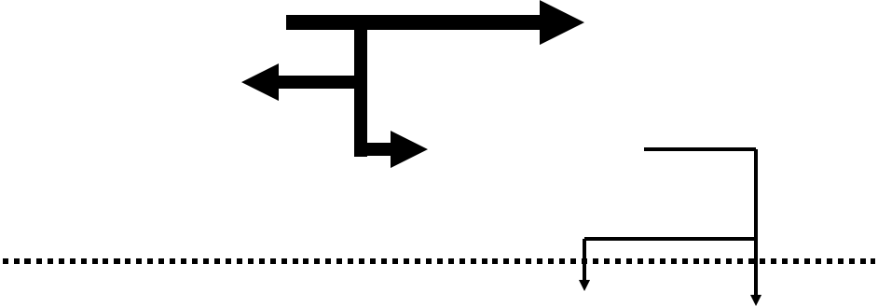













ARCHITECTURE of 8086
∑
Memory
Interface
FIFO
Bus Interface
Unit
EXTRA SEGMENT (ES)
CODE SEGMENT (CS)
6
5
4
3
2
1
STACK SEGMENT (SS)
DATA SEGMENT (DS)
Instruction Queue
INSTRUCTION POINTER (IP)
Instruction
Decoder
AH
AL
AX
BH
BL
BX
ARITHMETIC
LOGIC UNIT
CH
CL
CX
DH
DL
DX
CONTROL
SYSTEM
STACK POINTER (SP)
BASE POINTER (BP)
OPERANDS
SOURCE INDEX (SI)
FLAGS
Execution
Unit
DESTINATION INDEX (DI)

Slide 7













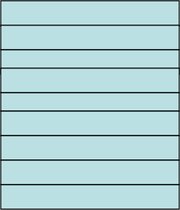







8086 REGISTER ORGANIZATION
ES
CS
SS
DS
IP
Extra Segment
Code Segment
Stack Segment
Data Segment
Instruction Pointer
Type
Register
size
Name of the
Register
General
purpose
registers
16 bit
AX, BX, CX, DX
8 bit
AL, AH, BL, BH,
CL, CH, DL, DH
AX
BX
CX
DX
AH
BH
AL
BL
CL
DL
Accumulator
Base Register
Count Register
Pointer
registers
16 bit
SP, BP
CH
DH
Data Register
Indexed
registers
16 bit
SI, DI
SP
Stack Pointer
Base Pointer
Source Index
Destination Index
BP
SI
DI
FLAGS
Instruction
Pointer
16 bit
IP
Segment
registers
16 bit
CS, DS, SS, ES
Flags
16 bit
Flag register

Slide 8
General Purpose Registers
8086 has 8 general purpose registers which:
➢Can be individually used for storing 8-bit data
➢Two registers can be combined to store 16-bit data
➢ Valid register pairs are: AX, BX, CX, DX
➢AX is also called Accumulator having some special features
➢BX, also called Base Register is the only general purpose
register which can also be used in based-addressing mode
➢ CX is also used as a default Counter Register in some
instructions (SHIFT, ROTATE & LOOP)
➢ DX or Data Register is also
used by default to store upper
16-bit data in division and
multiplication operations
Acc.
AH
AL
AX
Base
BH
BL
BX
Counter
CH
CL
CX
Data
DH
DL
DX

Slide 9













8086 REGISTER ORGANIZATION : FLAG REGISTER
Auxiliary Carry Flag
Carry Flag
This is set, if there is a carry from the lowest
nibble, i.e, bit three during addition, or
borrow for the lowest nibble, i.e, bit three,
during subtraction.
This flag is set, when there is a
carry out of MSB in case of
addition or a borrow in case of
subtraction.
Sign Flag
Zero Flag
Parity Flag
This flag is set, when the result
of any computation is negative
This flag is set, if the result of the
This flag is set to 1, if the lower byte of
the result contains even number of
1’s ; for odd number of 1’s set to zero.
computation
comparison
performed by an instruction is zero
or
15
14
13
12
11
10
9
8
7
6
5
4
3
2
1
0
OF
DF
IF
TF
SF
ZF
AF
PF
CF
Tarp Flag
If this flag is set, the processor
Over flow Flag
enters
mode
the
by
single
This flag is set, if an overflow occurs, i.e, if the result of a signed operation
is large enough to accommodate in a destination register. The result is of
more than 7-bits in size in case of 8-bit signed operation and more than 15-
bits in size in case of 16-bit sign operations, then the overflow will be set.
step
generating
execution
internal
interrupts after the execution
each instruction
of
Direction Flag
Interrupt Flag
This is used by string manipulation instructions. If this flag bit is ‘0’, the
string is processed beginning from the lowest address to the highest
address, i.e., auto incrementing mode. Otherwise, the string is
processed from the highest address towards the lowest address, i.e.,
auto incrementing mode.
Causes the 8086 to recognize external
mask interrupts; clearing IF disables these
interrupts.
10

Slide 10
8086 MEMORY ADDRESSING
8086 supports 2 = 1,048,576 bytes (1Mbytes) of memory over the
address range 00000 to FFFFF (00000H to FFFFFH)
20
16
16
➢
➢
Two consecutive bytes can be accessed as one word (16-bits)
The lower-addressed byte is the least significant byte of the word, and
the higher-addressed byte is its most significant byte
➢
Memory space of 1MB is divided into two chips (called banks) of
512KB each having even & odd addresses
➢ This is done because most memories are ‘byte-oriented’ (1 byte
Read /write at a time), but as 8086 is capable to read/write 16-bit (2
bytes) at a time, we need to use two chips for 16-bit word operations

Slide 11

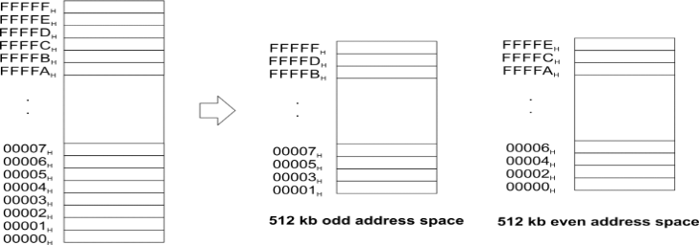
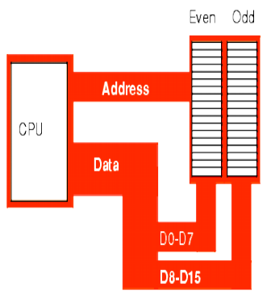
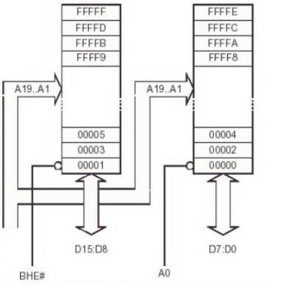

Slide 12
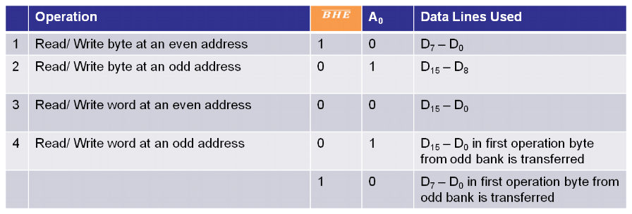
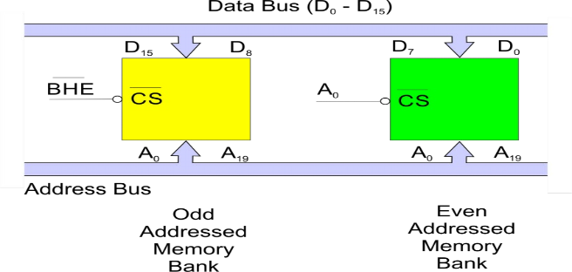
8086 MEMORY ADDRESSING
(Also called BLE)

Slide 13
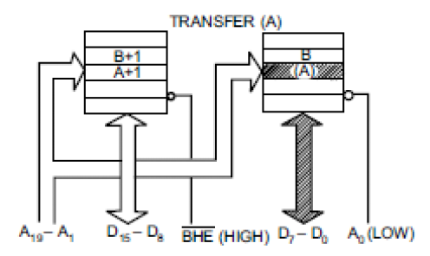
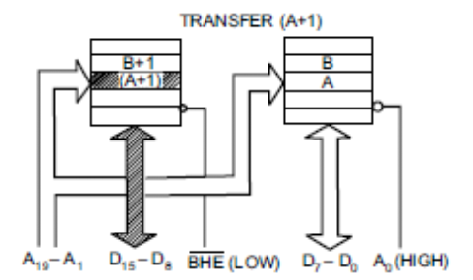
Memory Addressing: BYTE/WORD TRANFER IN 8086
A, B = any assumed
memory location address in
even, odd banks. Brackets
indicate contents of
location & not address

Slide 14


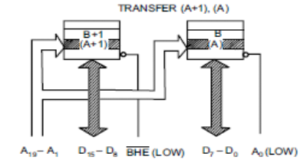

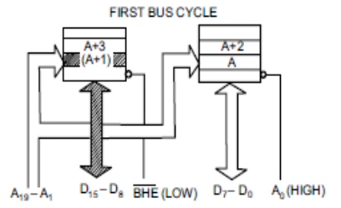
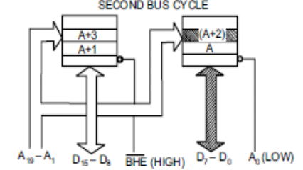

Memory Addressing: BYTE/WORD TRANFER IN 8086
Aligned
word
Misaligned
word
A word stored at an even-address boundary (00000H, 00002H, 00004H etc) is said to be
an aligned word while a word stored at an odd address boundary (00001H, 00003H,
00005H etc) is called misaligned word. A misaligned word requires two read
operations (or bus cycles) & thus double time

Slide 15
Memory Segmentation in 8086
➢ 8086 has a 20-bit address bus & thus can address a maximum of
1MB of memory
➢ But 8086 has 16-bit registers which can hold only 16-bit addresses
➢ Solution is to divide 1MB memory in 64KB segments (total sixteen)
as they can be accessed by using 16-bit addresses. However, only 4
segments are accessible by 8086 at a time. These 4 segments are:
• Code segment: Used for storing the codes or instructions
• Stack segment: Used as a stack
• Data segment: Used for storing data
• Extra segment: Used for storing in-excess data
➢ Address of a segment is of 20-bits, however, within a segment a
memory location can be specified or accessed using a 16-bit
address called effective address or offset

Slide 16
Advantages of Memory Segmentation
Advantages of Memory Segmentation:
➢Allows the memory capacity to be 1MB although actual addresses to
➢
be handled are of 16-bit size
➢ Allows the placing of code, data and stack portions of the same
program in different parts (segments) of the memory, for data and
code protection.

Slide 17









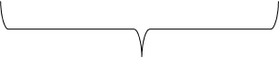

Intel
Physical Address Generation in 8086
➢ The 20-bit physical address is generated by adding 16-bit contents of a
segment register with an 16-bit offset value (also called Effective Address)
which is stored in a corresponding default register (either in IP, BX, SI, DI,
BP or SP. Different segments have different default register for offset, for
example IP is default offset register for Code Segment)
➢ BIU always appends 4 zeros automatically to the 16-bit address of a segment
register (to make it 20-bit) because it knows the starting address of a
segment always ends with 4 zeros
Points to a memory
location within a
segment
Offset Value (16 bits)
CS
DS
ES
SS
Segment Register (16 bits)
0 0 0 0
IP
BX
DI
BP
Upper 16bit of starting
address of a segment
20-bits
16-bits
DI
SP
Actual address for
memory
Adder
SI
Default Registers Assigned to store
offset values for different segments
Physical Address (20 Bits)

Slide 18

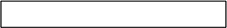
Physical Address Calculation
Offset is derived from the combination of
pointer registers, index registers the
Instruction Pointer, and immediate values
(called displacement)
Segment address
0000
+
Offset
Memory address
❑

Slide 19
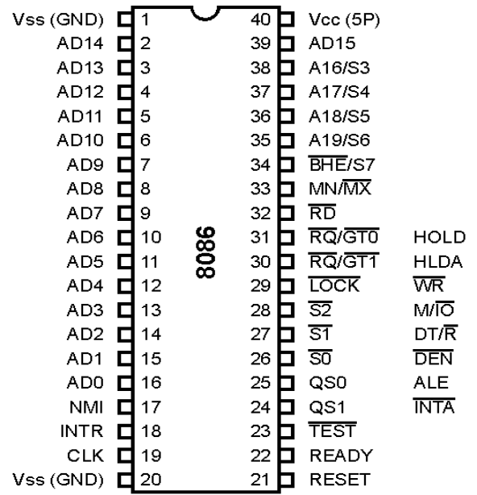



Pin Diagram of 8086: Operating Modes
This set of
pins works in
two modes
For Minimum Mode
For Maximum Mode

Slide 20
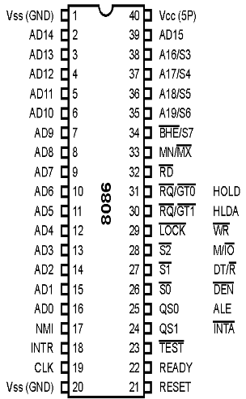

AD – AD
(Bi-directional)
0
15
➢These lines are multiplexed
bi-directional address/data
bus.
➢During T1 , they carry lower
order 16-bit address.
➢In the remaining clock
cycles, they carry 16-bit
data.
➢AD -AD carry lower order
byte of data.
➢AD -AD carry higher order
byte of data.
0
7
8
15

Slide 21
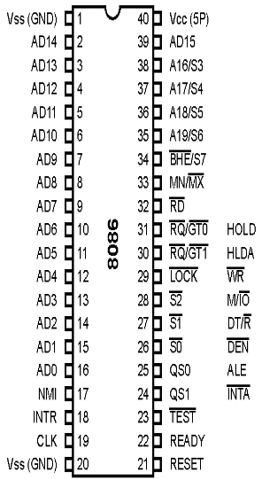

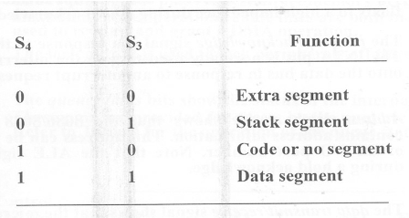
A /S , A /S , A /S , A / S
19
6
18
5
17
4
16
3
(Unidirectional)
➢These lines are multiplexed
unidirectional address and
status bus.
➢During T , they carry higher
order 4-bit address.
1
➢In the remaining clock cycles,
they carry status signals.

Slide 22
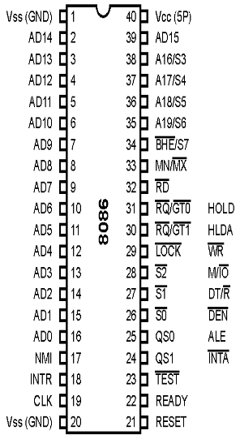

BHE / S (Output)
7
➢BHE stands for Bus High
Enable.
➢BHE signal is used to
indicate the transfer of data
over higher order data bus
(D – D ).
8
15
➢It is multiplexed with status
pin S .
7

Slide 23
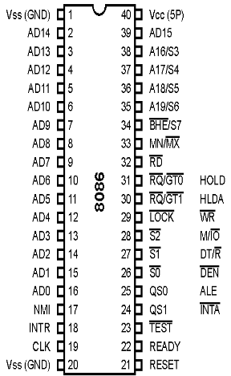
RD (Read) (Output)
➢It is a read signal used
for read operation.
➢It is an output signal.
➢It is an active low
signal.

Slide 24
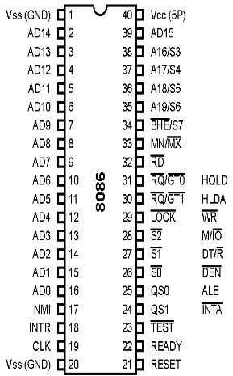
READY (Input)
➢This is an acknowledgement
signal from slower I/O
devices or memory.
➢It is an active high signal.
➢When high, it indicates that
the device is ready to transfer
data.
➢When low, then
microprocessor is in wait
state.

Slide 25
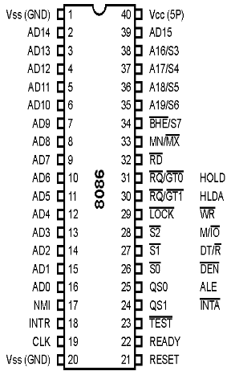

RESET(Input)
➢It is a system reset.
➢It is an active high signal.
➢When high, microprocessor
enters into reset state and
terminates the current
activity.
➢It must be active for at least
four clock cycles to reset
the microprocessor.

Slide 26
INTR (Input)
➢It is an interrupt request
signal.
➢It is active high.

Slide 27
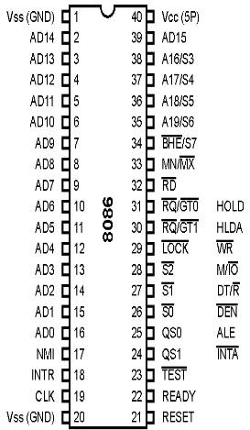
NMI (Input)
➢It is a non-maskable
interrupt signal.
➢It is an active high.

Slide 28
TEST (Input)
➢If low, execution in microprocessor continues else microprocessor is in
wait state.

Slide 29

CLK (Input)
➢This clock input provides
the basic timing for
processor operation.
➢ The range of frequency of
different versions is 5 MHz,
8 MHz and 10 MHz.

Slide 30



V
and V
CC
SS
(Input)
➢V is power supply signal.
CC
➢+5V DC is supplied
through this pin.
➢V is ground signal.
SS

Slide 31

MN / MX (Input)
➢8086 works in two modes:
• Minimum Mode
• Maximum Mode
➢If MN/MX is high, it works
in minimum mode.
➢If MN/MX is low, it works in
maximum mode.

Slide 32

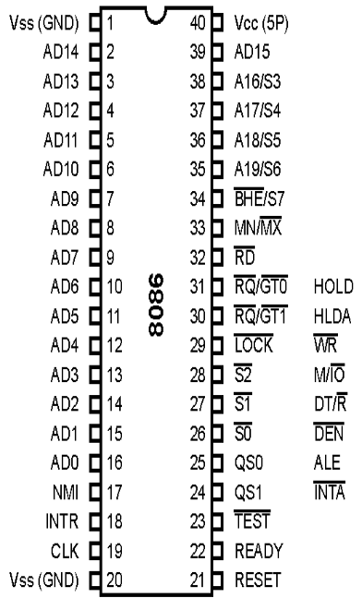
➢Pins 24 to 31 issue two
different sets of signals.
➢One set of signals is
issued when CPU
operates in minimum
mode.
➢Other set of signals is
issued when CPU
operates in maximum
mode.

Slide 33

Minimum Operating Mode

Slide 34
INTA (Output)
➢This is an interrupt
acknowledge signal.
➢When microprocessor
receives INTR signal, it
acknowledges the interrupt
by generating this signal.
➢It is an active low signal.

Slide 35
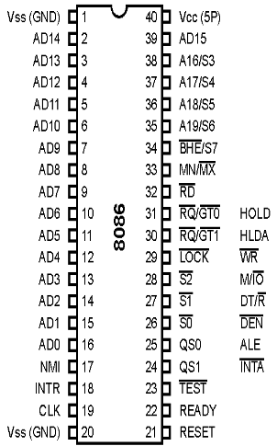
ALE (Output)
➢This is an Address Latch
Enable signal.
➢It indicates that valid
address is available on bus
AD – AD .
0
15
➢It is an active high signal
and remains high during T
1
state.

Slide 36

DEN (Output)
➢This is a Data Enable signal.
➢This signal is used to enable
the transceiver 8286.
➢Transceiver is used to
separate the data from the
address/data bus.
➢It is an active low signal.

Slide 37
DT / R (Output)
➢This is a Data
Transmit/Receive signal.
➢It decides the direction of
data flow through the
transceiver.
➢When it is high, data is
transmitted out.
➢When it is low, data is
received in.

Slide 38
M / IO (Output)
➢This signal is issued by the
microprocessor to
distinguish memory
access from I/O access.
➢When it is high, memory is
accessed.
➢When it is low, I/O devices
are accessed.

Slide 39
WR (Output)
➢It is a Write signal.
➢It is used to write data in
memory or output device
depending on the status of
M/IO signal.
➢It is an active low signal.

Slide 40
HOLD (Input)
➢When DMA controller
needs to use address/data
bus, it sends a request to
the CPU through this pin.
➢It is an active high signal.
➢When microprocessor
receives HOLD signal, it
issues HLDA signal to the
DMA controller.

Slide 41
HLDA (Output)
➢It is a Hold Acknowledge
signal.
➢It is issued after receiving
the HOLD signal.
➢It is an active high signal.

Slide 42
Maximum Operating Mode

Slide 43













QS and QS (Output)
1
0
These pins provide the
status of instruction queue.
QS
QS
Status
1
0
0
0
No operation
0
1
1 byte of opcode from queue
st
1
0
Empty queue
1
1
Subsequent byte from queue

Slide 44

S , S , S
0
1
2
(Output)
➢These status signals
indicate the operation being
done by the microprocessor.
➢This information is required
by the Bus Controller 8288.
➢Bus controller 8288
generates all memory and
I/O control signals.

Slide 45



















S , S , S
0
1
2
(Output)
S
S
S
Status
2
1
0
0
0
0
Interrupt Acknowledge
0
0
1
I/O Read
0
1
0
I/O Write
0
1
1
Halt
1
0
0
Opcode Fetch
1
0
1
Memory Read
1
1
0
Memory Write
1
1
1
Passive

Slide 46

LOCK (Output)
➢This signal indicates that other
processors should not ask CPU
to relinquish the system bus.
➢When it goes low, all interrupts
are masked and HOLD request
is not granted.
➢This pin is activated by using
LOCK prefix on any instruction.

Slide 47

RQ/GT and RQ/GT (Bi-directional)
1
0
➢These are Request/Grant pins.
➢Other processors request the
CPU through these lines to
release the system bus.
➢After receiving the request,
CPU sends acknowledge signal
on the same lines.
➢RQ/GT has higher priority than
0
RQ/GT .
1

Slide 48
8086 Minimum Mode
➢In the minimum mode of 8086, MN/MX pin is connected
to logic 1 (+5V )
➢ There is a single processor (8086) in this mode
➢ All the control signals are given out by the microprocessor
chip itself.
➢ Other supporting components in the system are latches,
transreceiver, clock generator, memory and I/O devices.
➢ Requires less (or minimum) hardware (than maximum
mode) & thus less costly but can not be used in large
multiprocessor systems

Slide 49
8086 Maximum Mode
➢ In the maximum mode, the 8086 is operated by connecting MN/MX
pin to ground (logic 0).
➢ In the maximum mode, there may be more than one processor in
the system
➢ A bus controller (8288) is also used in this mode which is connected
to 8086 by using status signals S2,S1,S0. Some of the control
signals in this mode are generated by 8288 instead of 8086
➢ 8288 derives (regenerates) various control signals like ALE, DEN,
DT/R, Memory read/write (MRDC, MWTC), I/O read/write (IORC,
IOWC), AMWC & AIOWC by using information at status signals
S2,S1,S0 supplied by 8086
➢ Other supporting components in the system are same as in
minimum mode (latches, transreceiver, clock generator, memory
and I/O devices)
➢This mode is costly due to greater hardware but is useful in large
multiprocessor systems

Slide 50
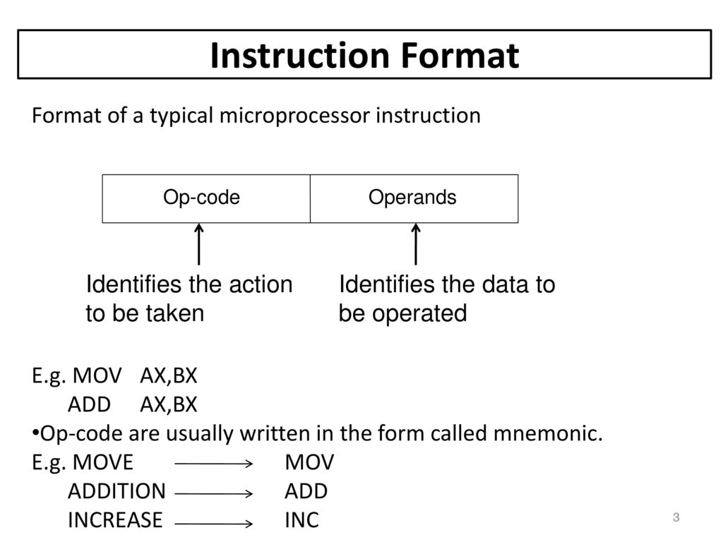
INSTRUCTION FORMAT of 8086

Slide 51
INSTRUCTION SET and TYPES of Instruction of 8086
An Instruction is a binary pattern designed inside a microprocessor to perform a specific function.
An Instruction Set is group of instructions support by microprocessor.
Types of Instructions:
Data Transfer Instruction
Arithmetic Instruction
Bit Manipulation Instruction
Program Execution Transfer Instruction
String Instruction
Processor Control Instruction

Slide 52
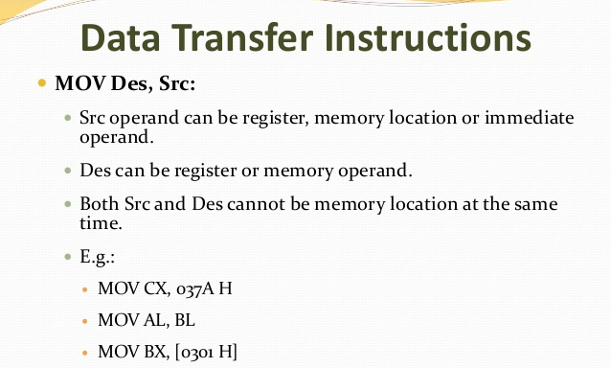

Slide 53
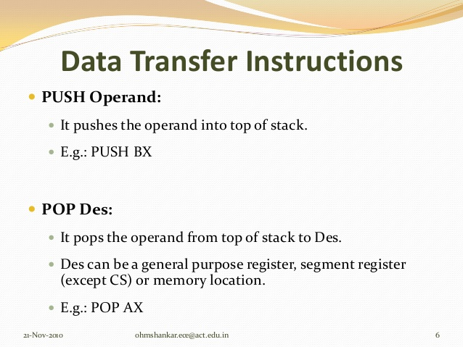

Slide 54
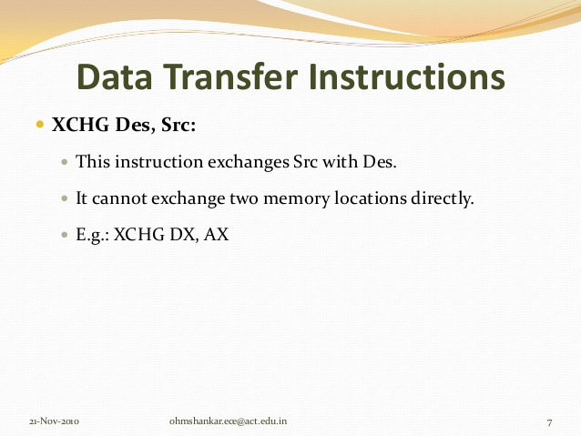

Slide 55
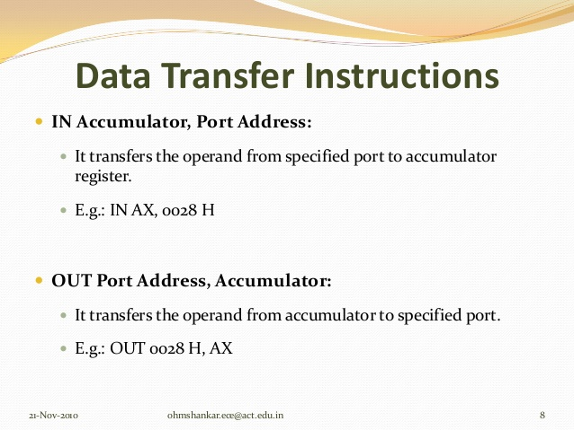

Slide 56
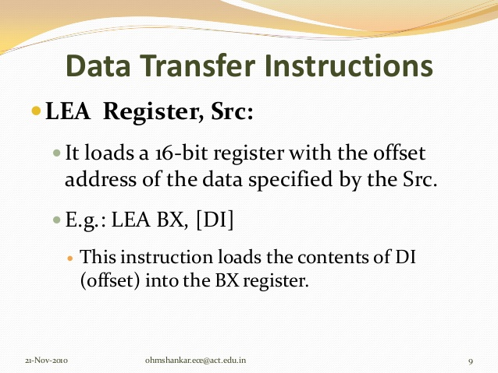

Slide 57
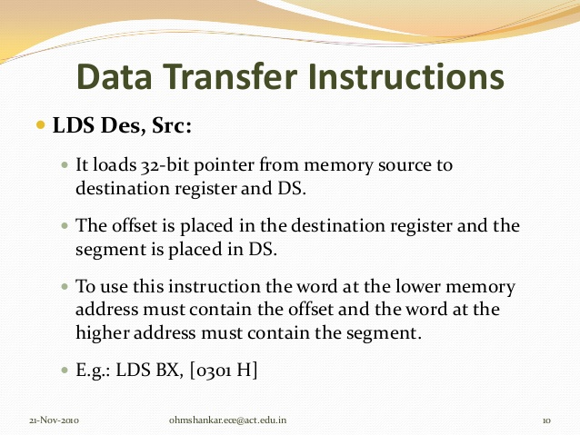

Slide 58
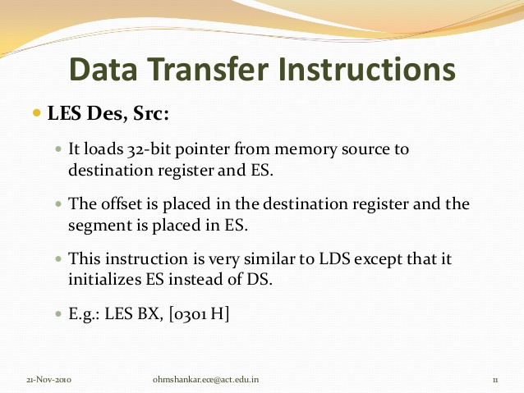

Slide 59
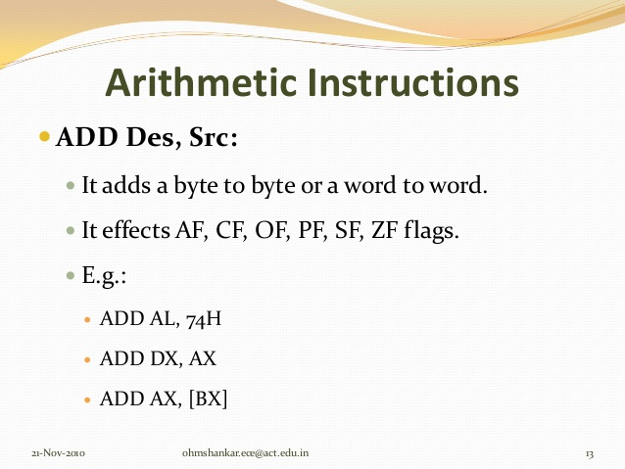

Slide 60
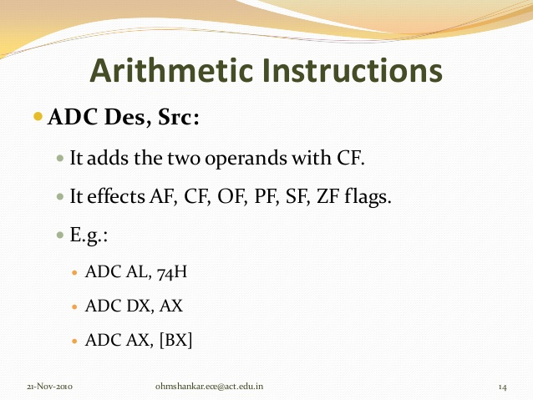

Slide 61
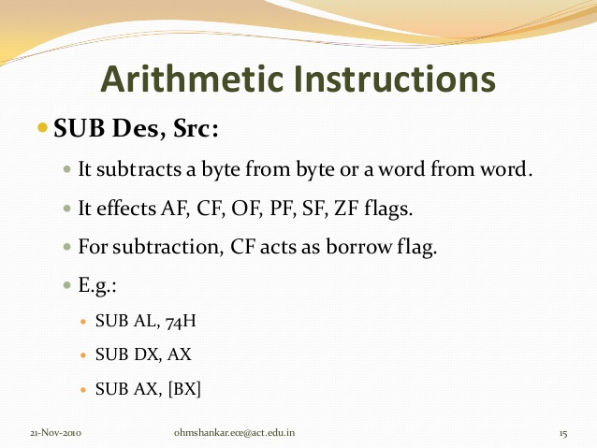

Slide 62
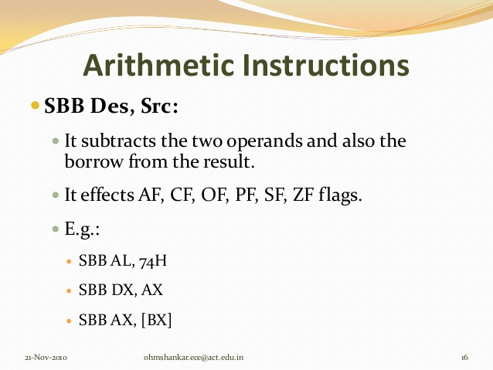

Slide 63
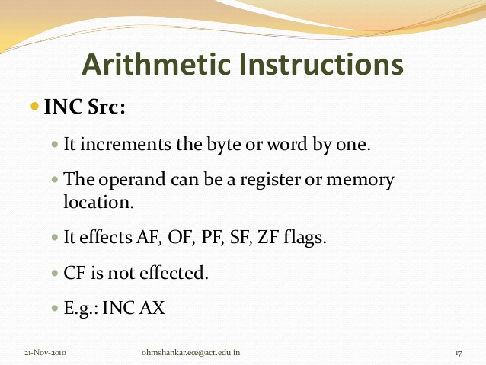

Slide 64
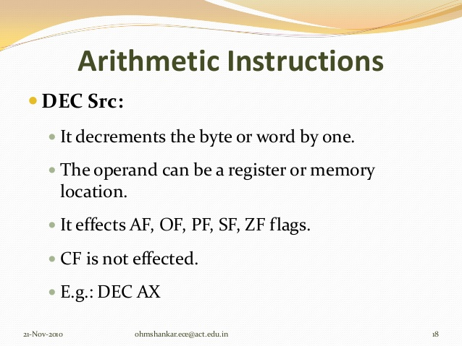

Slide 65
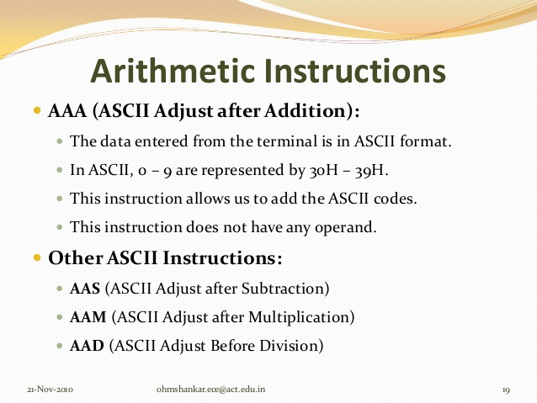

Slide 66
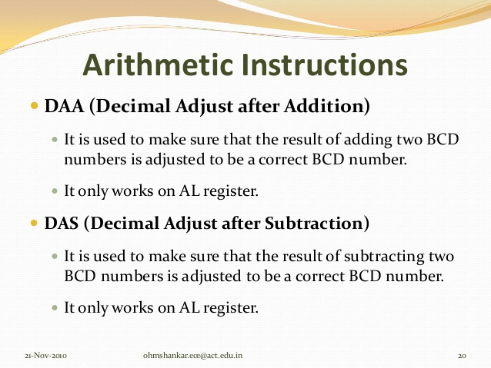

Slide 67
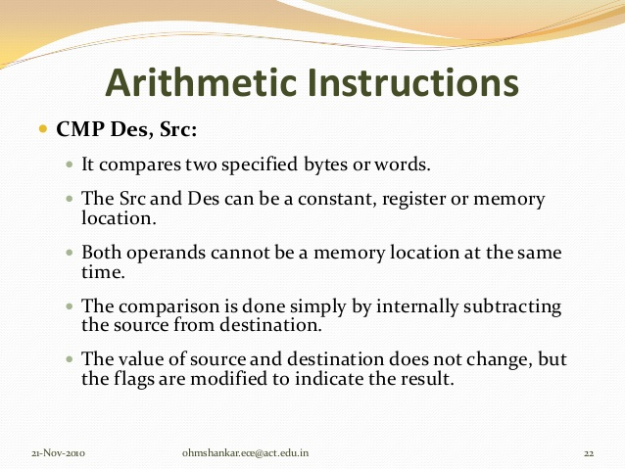

Slide 68
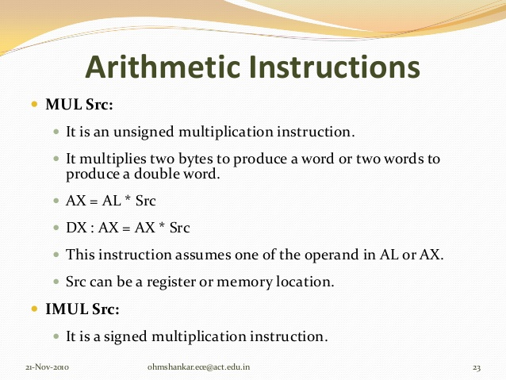

Slide 69
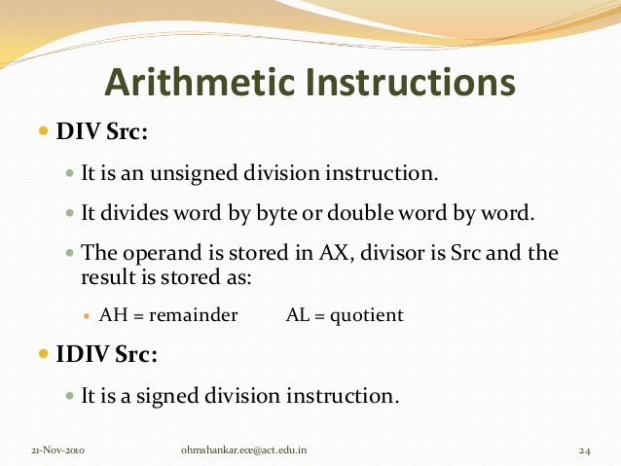

Slide 70
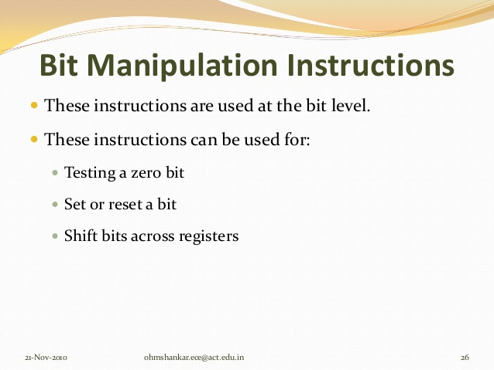

Slide 71
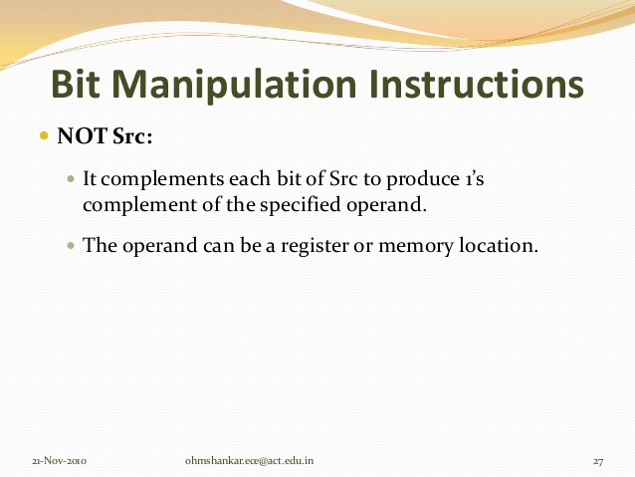

Slide 72
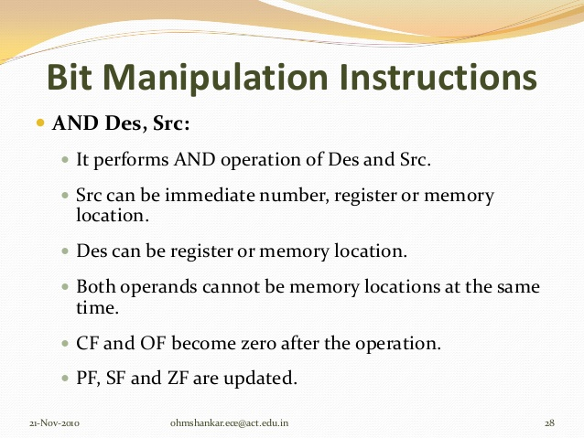

Slide 73


Slide 74


Slide 75
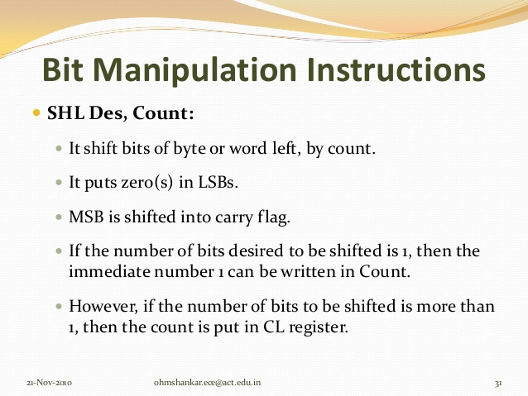

Slide 76
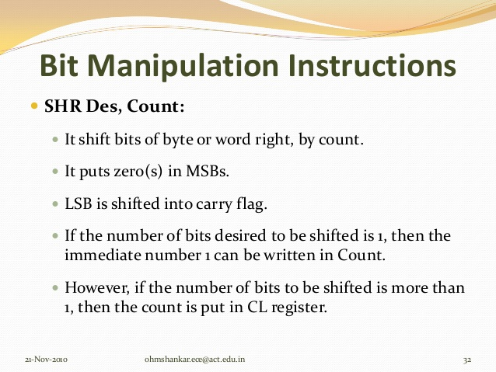

Slide 77
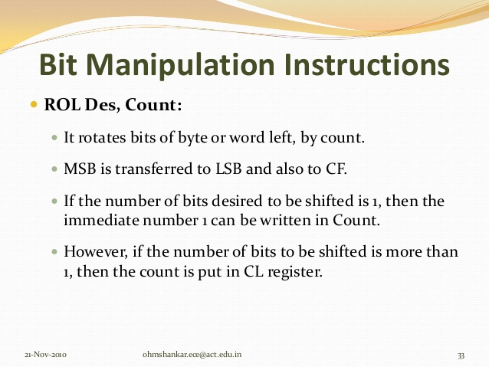

Slide 78


Slide 79


Slide 80


Slide 81


Slide 82


Slide 83


Slide 84


Slide 85


Slide 86


Slide 87


Slide 88


Slide 89


Slide 90


Slide 91

INTERRUPTS OF 8086

Slide 92

HARDWARE INTERRUPTS OF 8086

Slide 93

HARDWARE INTERRUPT OF 8086

Slide 94
2 5 6 I n t e r r u p t s o f 8 0 8 6 a r e D i v i d e d i n t o
3 G r o u p s
SOFTWARE INTERRUPT OF 8086
1 . T y p e 0 0 t o T y p e 0 4 i n t e r r u p t s -
These are used for fixed operations and hence are called
dedicated interrupts
2. T y p e 0 5 t o T y p e 3 1 i n t e r r u p t s
Not used by 8086,reserved for higher processors like 80286
80386 etc.
3. T y p e 3 2 t o T y p e 2 5 5 i n t e r r u p t s
Available for user, called user defined interrupts. These can be
either H/W interrupts and activated through INTR line or can
be S/W interrupts.

Slide 95
THANK YOU
STUDENTS
Be Safe and Stay at home

